Slide 1
Social enterprise
“Here’s my advice: The first step to becoming a
changemaker (the only secure job going forward) is to
give oneself permission, i.e., to ignore — politely, of
course — all those who say 'Don’t do it.”
Bill Drayton, Founder& Chairman of Ashoka
Businesses created
to do good
Notes:
Ashoka's History
Bill Drayton founded Ashoka in 1980 based on the idea that the most powerful force for good in the world is a social entrepreneur: a person driven by an innovative idea that can help correct an entrenched global problem. The world’s leading social entrepreneurs pursue system-changing solutions that permanently alter existing patterns of activity.

Slide 2
What is a social enterprise?
Social enterprises are businesses that:
have a defined primary social purpose, cultural, environmental or other public benefit
derive a substantial portion of its income from trade; rather than through grants, donations or gifts.
reinvest 50% or more of annual profits towards achieving their social purpose
Social enterprises are commercially viable businesses existing to benefit the public and the community, rather than shareholders and owners.

Slide 3
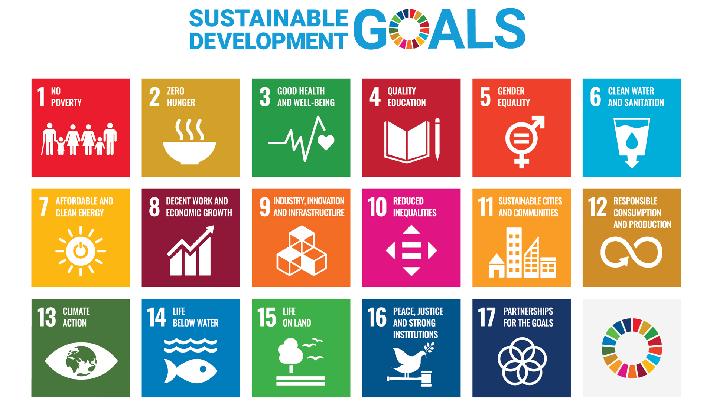
Impact Measurement & the Sustainable Development Goals (SDG's)
Notes:
The Sustainable Development Goals are set of 17 goals and 169 targets agreed by all United Nation (UN) member states with the aim to achieve a better and more sustainable future for all. They address the global challenges we face, including those related to poverty, inequality, climate, environmental degradation, prosperity, and peace and justice. The Goals interconnect and in order to leave no one behind, it is important that we achieve each Goal and target by 2030.

Slide 4
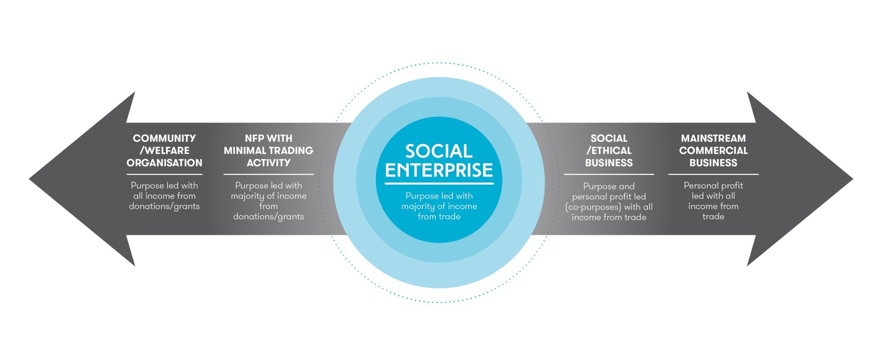
What is a social enterprise?
Often described as the point where not-for-profit meets business, a social enterprise’s primary purpose is to benefit the community and/or environment rather than provide financial return to shareholders and owners.

Slide 5
WHY start a social enterprise?
You have a personal connection/understanding of the issues or problem.
You have researched/connected with the beneficiaries and your solution is viable and valued.
You have a practical business idea will generate income to help solve the problem.
You have products and services that you can offer to meet the need.
You have looked at the SDGs and you can design your business to “do no harm” to social, cultural and environmental outcomes.
You want to make a lasting difference to you and the others in your value chain.
Social enterprises go beyond ”business as usual” to serve their community and build an added value into their transactions. It is their reason for being.
Notes:
The Queensland Social Enterprise Strategy is the Queensland Government's commitment to supporting the growth of the social enterprise sector in Queensland.
Social enterprises exist to benefit the public and community rather than shareholders and owners. The sector is gaining momentum in Queensland and plays an important role in delivering jobs and training opportunities for disadvantaged Queenslanders.
The strategy outlines 3 key focus areas of targeted support to address the challenges social enterprises face:
building capability and capacity in the sector including access to financial support
making connections across the sector to increase collaboration and promotional opportunities
improving market access by linking social enterprises to procurement opportunities.

Slide 6
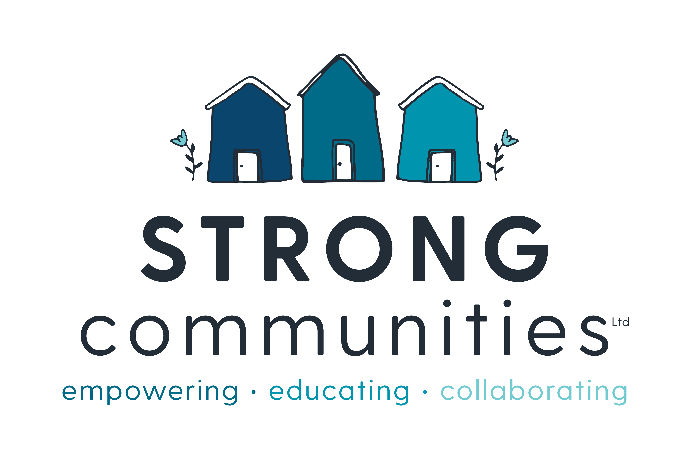
EXAMPLE social enterpriseS
Notes:
Jobs-Focused Social Enterprises. Focuses on creating meaningful employment for disadvantaged Australians. Nearly 7,000 of all social enterprises in Australia have employment-based support or employment creation as their main focus. Some provide service for temporary jobs, job readiness programs and support to entry mainstream employment. Some provide long-term job opportunities with wrap around support services. ALL are required to offer fair pay for equity and justice.
Circular Economy Social Enterprises. It entails gradually decoupling economic activity from the consumption of finite resources, and designing waste out of the system. Revenue is gained through sale of products or services that reduce waste and increase the value of the inputs and throughputs to the system.
Co-operative Social Enterprises. A cooperative is "an autonomous association of persons united voluntarily to meet their common economic, social, and cultural needs and aspirations through a jointly-owned enterprise. Revenue is often split between cooperative members, and go toward the sustainability of the practice.
Physical and Mental Wellbeing Social Enterprises. Focus on services that improve the physical or metal wellbeing of disadvantaged cohorts. Revenue comes from sale of services and products often that reduce barriers to access, offer bulk or cooperative approaches to democratise or decentralise services.

Slide 7
social procurement = Winning Tenders
Social Enterprises come in many forms, from coffee shops to law firms, but each one exists to help solve a problem in our community.
As social enterprises exist to drive social and environmental change, buying goods and services from them is the most effective means of breaking the cycle of disadvantage for thousands of Australians and people around the World.
Buying from social enterprises is something that can be done by government, business and consumers through responsible purchasing. When business and government choose to buy from social enterprise we refer to this as social procurement. In essence, you get the product or service that you would have gotten from a commercial supplier, but you also get the added value created by the SE.
Being a “certified” social enterprise can help this process. QSEC works with Social Traders to assist with this. https://www.socialtraders.com.au/
The power of buying socially means that every time goods and services are bought from a social enterprise, positive social change is also created
Notes:
CD workers can help by starting this conversation with their procurement team. Knowing the conditions, objectives and skillset of your local social enterprises, understanding the projects that may be coming up, preparing the conversation aout what conditions suit the project and the social enterprises. QSEC works with Social Traders

Slide 8
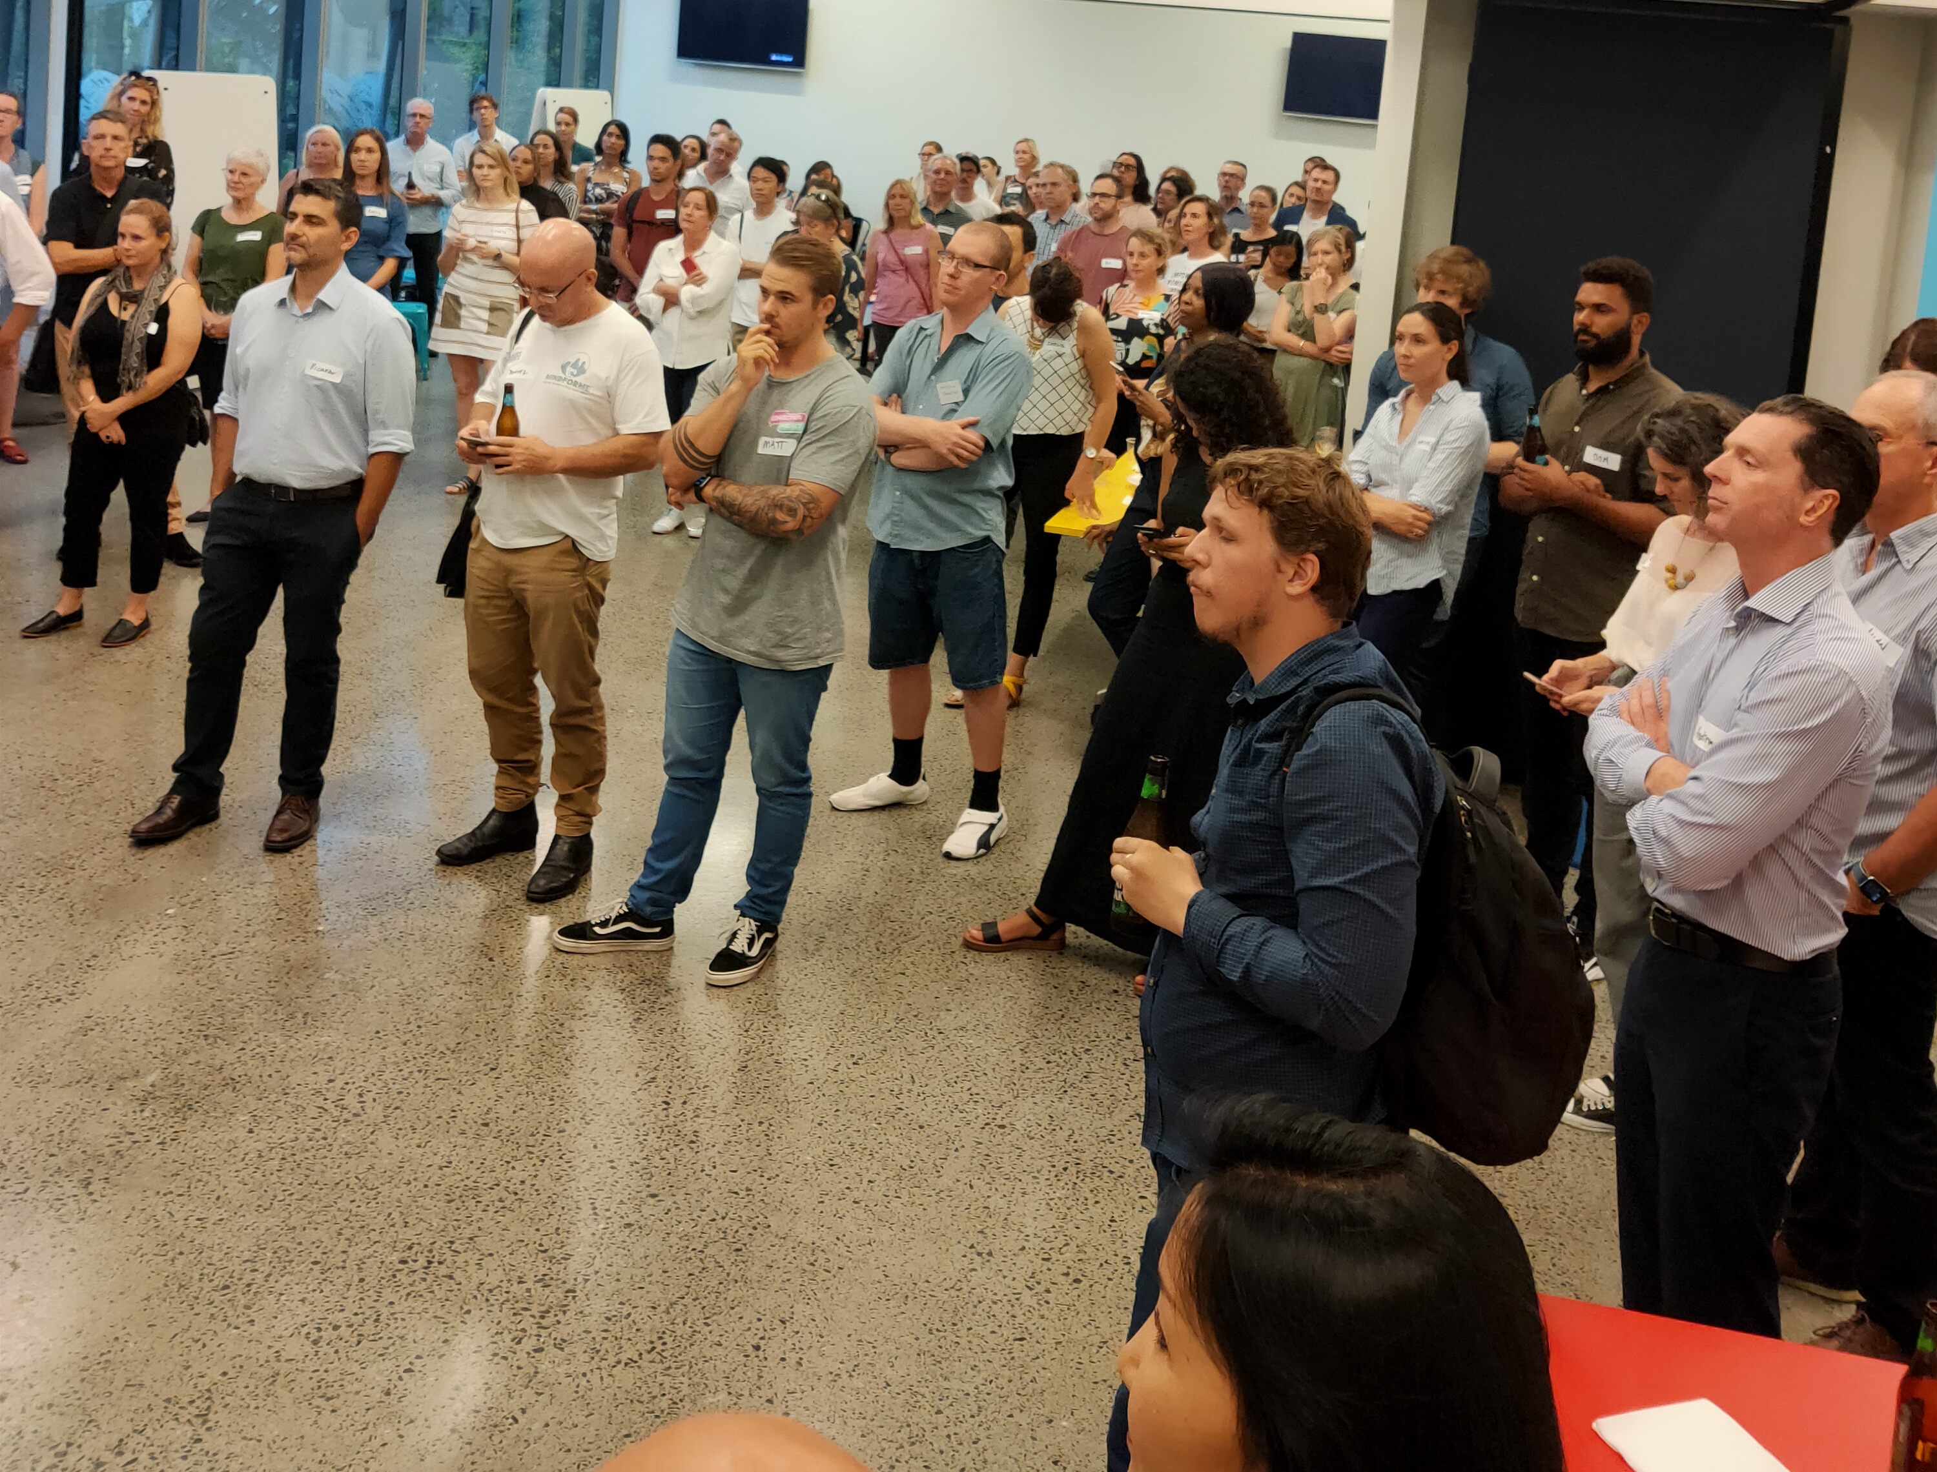
Who is QSEC?
Notes:
https://youtu.be/pN_I5rY1Lb8

Slide 9
FIND YOUR LOCAL SOCIAL ENTERPRISES QSEC.org.au

Slide 10
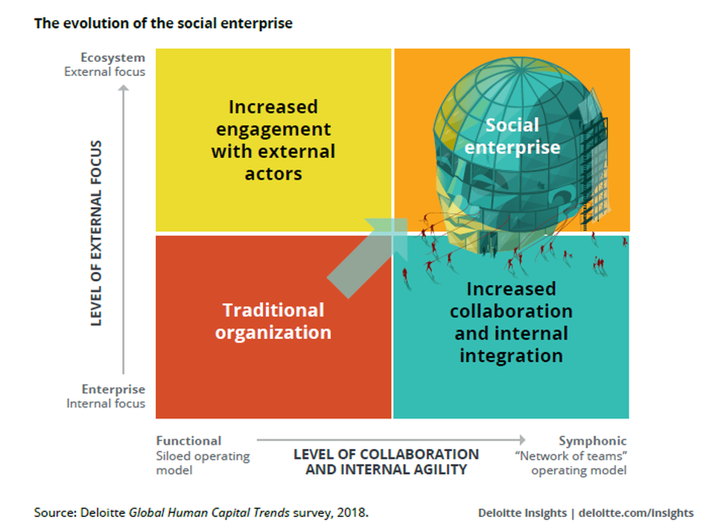
Social Enterprise = LOCAL LIVING ECONOMIES
Josh Bersin, 2013, The Rise of Social Enterprise: A new paradigm for business. Forbes Magazine
Michael Porter The Case for letting business solve social problems
Kate Raworth Doughnut Economics
Michael Shuman Local Living Economies
Growing Local living economies : A Grassroots Approach to Economic Development
Michael H. Shuman, Kate Poole, Business Alliance for Local Living Economies - BALLE, Bellingham, Wa- USA, January 2013

Slide 11
3 x Regional towns
3 x 2-day workshops
50 + Social enterprise participants
F2F & Digital online learning
6 LOCAL ECONoMIC Recovery projects

Slide 12
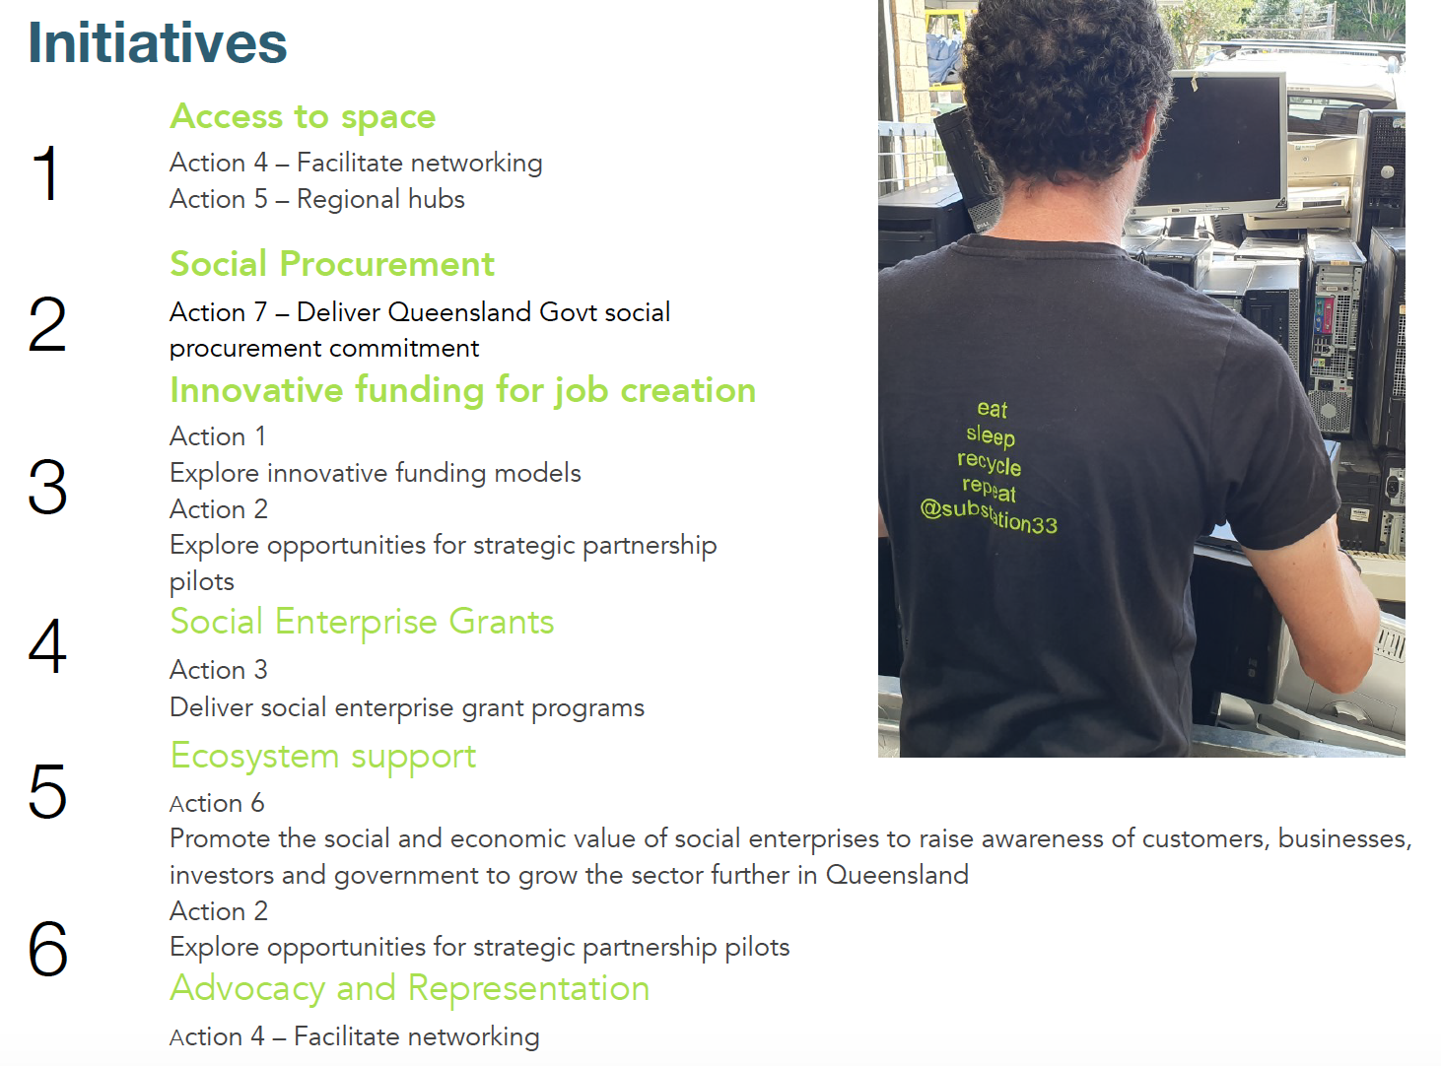
$8M for social enterprise

Slide 13
“When our grandchildren ask us where we were when the
voiceless and the vulnerable in our era needed leaders of
compassion and purpose, I hope we can say that we
showed up, and that we showed up on time.”
Gary Haugen, Founder of International Justice Mission
Notes:
International Justice Mission is a global organization that protects people in poverty from violence. We partner with local authorities in 21 program offices in 14 countries to combat trafficking and slavery, violence against women and children, and police abuse of power.

